Slide 1
LEGAL ASPECTS OF MEDICAL RECORDS
DEBJANI MUKHER JEE

Slide 2
WHAT IS MEAN BY MEDICO LEGAL CASE ?
Medico legal is something that involves both medical and legal aspects.
Mainly :
Medical jurisprudence ( a BRANCH OF MEDICINE )
Medical Law ( a BRANCH OF LAW )
Medico legal case: it can be defined as a case of injury or ailment etc.in which investigations by the law enforcing agencies are essential to fix the responsibility regarding the causation of the said injury or ailment .
Or we can say, it’s a medical case with legal implications for the attending doctor , where the attending doctor , after taking history and examining the patient, thinks that some investigation by law enforcement agencies is essential and fix responsibility regarding the said injury or ailment according to the law.

Slide 3
What are the incidents will comes under the MLC?
Assault and battery, including domestic violence and child abuse .
Accidents like Road Traffic Accidents ( RTA)industrial accidents etc.
Cases of trauma
Electrical injuries
Poisoning , Alcohol Intoxication
Undiagnosed coma
Chemical injuries
Burns and scalds
Sexual offences
Criminal abortions
Attempted suicide
Cases of asphyxia as a result of hanging , drowning , suffocations, strangulation, etc.
Custodial deaths
Death Iin the operation theatre
Unnatural deaths
Death due to snake bite or Animal Bite
Fire arm injuries
Drug overdose
Dead brought to the accident and emergency dept / MI room ( Found Dead ) and death occurring within 24 hours of hospitalization without establishment of a diagnosis

Slide 4
Why To Manage MLC ?
ML cases are just as NON MLC sick / injured patients and the doctor is duty bound to treat as well as document the details.
It is a crucial piece of evidence
The responsibility of label any case as MLC rest solely with the attending medical practitioner.

Slide 5
What is POLICE INTIMATION
The police should be informed , undersection 39 of criminal procedure . Code, the attending MO is legally bound to inform the police about the arrival of a MLC.
Any failure to report the occurrence of a MLC may invite prosecution under section 176 and / or 202 of I.P.C . Simultaneously, the information should be given to ADH, STATION HEAD QUARTERS and to the concerned MILITARY Police (If req.)the communication should invariably be followed by communication in writing subsequently.
In case of discharge / tranmsfer/ death of such a case in the hospital, the police should be informed.
Generally 3 ccopies are available in the police intimation book
1st copy to nearest police station
2nd copy to incident occurred place – police station
3rd copy for medical records or in the police intimation book itself

Slide 6
DOCUMENTATION OF A MLC
Documentation is done in duplicate in a set Performa ( as per hospital policy )preferably in a clear and legible handwriting and in complete words without using shortcuts.
Cutting / overwriting etc should be avoided as much as possible and all corrections should be properly initialled. Abbreviations of any sort should be avoided.
Separate performa may be available for medical examination, examination of drunkenness etc.
All columns are filled up carefully and by the same doctor who had examined the patient.
The details are completed then and there, leaving no provisions as to be completed later on .

Slide 7
Investigation advised and findings to be entered
Treatment given at the site or on reporting .
The opinion to be recorded in mlc sheet, if opinion cant be given, under observation be given and singed by the doctor with name written in block letters.
Final opinion be given by same doctor making MLC in the original MLC sheet, after all investigations are completed .
After completion the doctor sign and mention his/her name in full below it with designation
After registration of a case as MLC thereafter all documents and registration forms bear the same MLC number including the discharge slip .
The patient is admitted or discharged with advice be entered into case sheet.
All mlc x rays be kept in dept. as evidence for court of law.
Special samples taken to be entered into the MLC sheet.
If the patient is dead, handed over to police for post mortem and not to relatives.
Copy of MLC sheet be handed over to police for further investigation against his signature and number on the copy .

Slide 8
GENERAL DETAILS
REGISTRATION NUMBER
MLC NO
NAME
S/D/W OF
AGE
SEX
RELIGION
OCCUPATION
RESIDENTIAL ADDRESS
BROUGHT BY ………………………………………….
DATE & TIME OF EXAMINATION
NAME OF THE POLICE STATION

Slide 9
TRANSFER OF MLC’S
The transfer hospital provides medical treatment within its capacity that minimizes the risks to the patient .
The receiving hospital:
A)has available space and qualified personnel for the treatment , &
b)has agreed to accept transfer and to provide appropriate treatment .
The transferring hospital sends all medical records (history , examination findings, resultsof all diagnostic tests, provisional diagnosis, and treatment provided)that are available at that time .
The informed written consent or certification as required.
The transfer is effected through qualified personnel and transportation equipment to providelife support measures during the transfer.

Slide 10
BROUGHT DEAD CASES
All the cases of unnatural deaths like accidents, burns,violence and sexual assaults etc. depending on the history obtained from the relatives or police accompanying the case should be labelled as medico legal and all the formalities must be done with informing the police constable on duty.
In all the brought dead cases where causality duty officer is very much satisfied after taking history and going through the records available, that the death was natural , he may not label them as medico legal purely as his discretion
In death certificate from against the column of cause of death one should write ‘NOT KNOWN BROUGHT DEAD’ . In no case it should be mentioned that cause of death should be determined after post mortem

Slide 11
BULLET INJURY CASES
The evidence required to be preserved is re;lated t the nature of a case. In injury cases, (like bullet injury / stab injury / burn )the following articles should be preserved in sealed envelopes :
Clothing worn by the patient showing evidence of injury such as tears, bulet holes, cuts, blood stains etc.
In case of multiple tears, cut or holes etc, each piece of evidence will encircled and numbered with matching description in the MLC report and case sheet
Bullets recovered from a body should be marked by etching an intial or a mark on bottom before preservation .
All evidence collected should be mentioned

Slide 12
POISONING CASES
In cases of suspected poisoning the following articles will be preserved and ensured that they are forwarded for forensic examination
Gastric lavage/ gastric contents/ vomitus and soiled clothing
Blood urine and any other relevant body fluid depending on the poison ingested.
IN SEXUAL OFFENCES ,
Clothing worn by the patient and showing evidence of blood stains or seminal stains, stains of mud , tears/ cuts etc.
Vaginal swab

Slide 13
MEDICO LEGAL CASE MANAGEMENT
The Management of a MLC may be described in following heads :
IDENTIFICATION
REGISTRATION AND REPORTING
MLC
CASE EXAM& GIVING OPINION
FINAL OPINION
INVESTIGATION & TREATMENT
PREPARATION OF RECORD

Slide 14
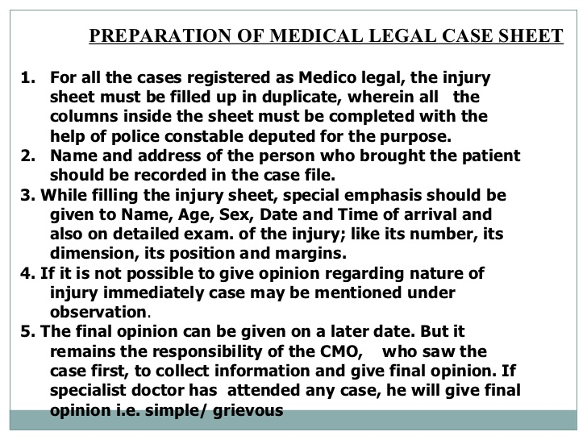

Slide 15
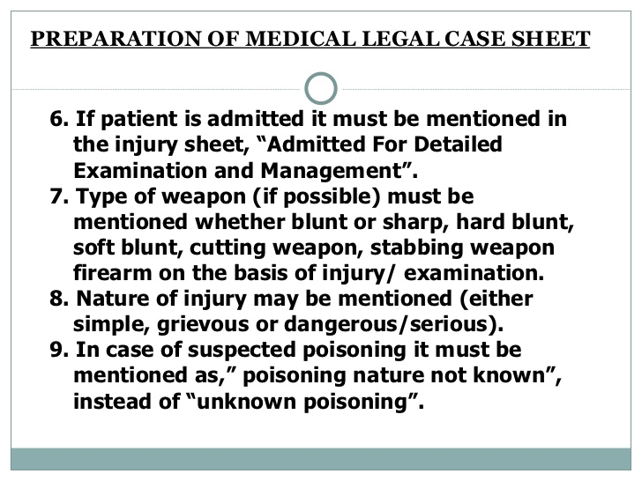

Slide 16
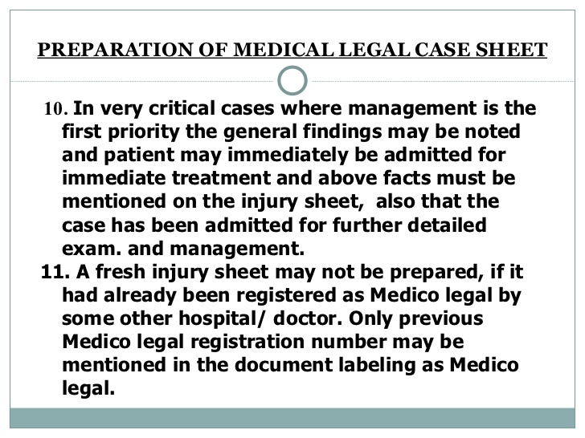

Slide 17
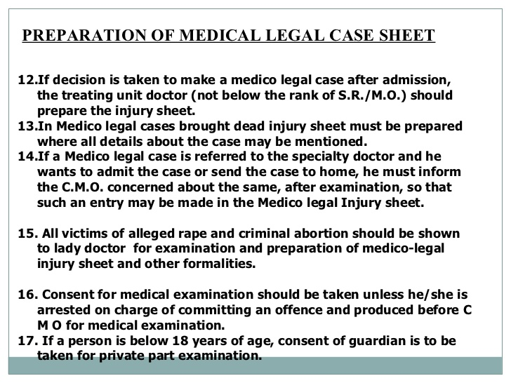

Slide 18
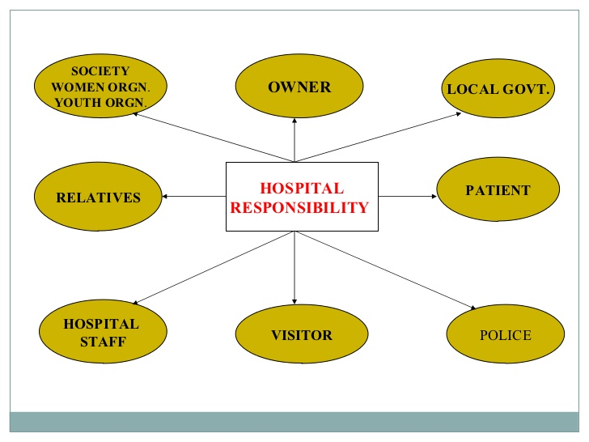

Slide 19
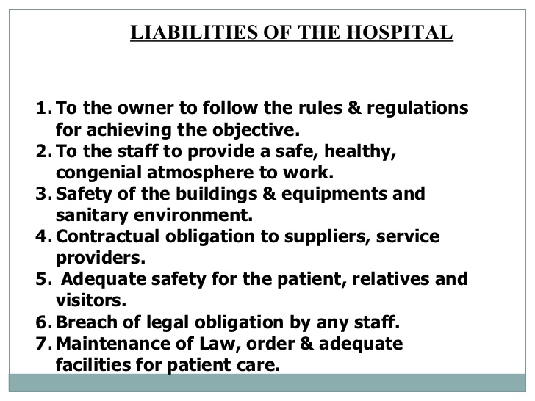

Slide 20
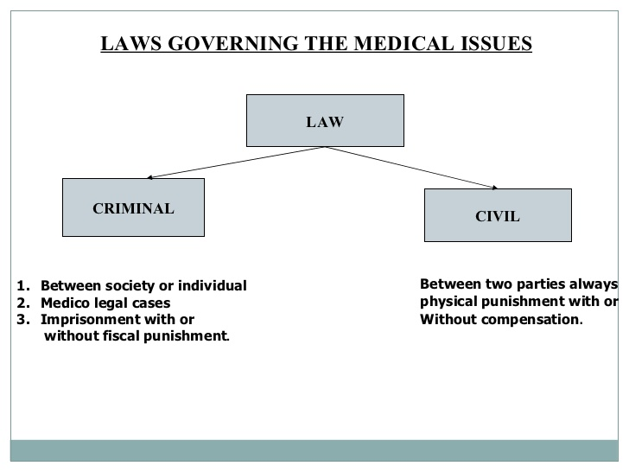

Slide 21
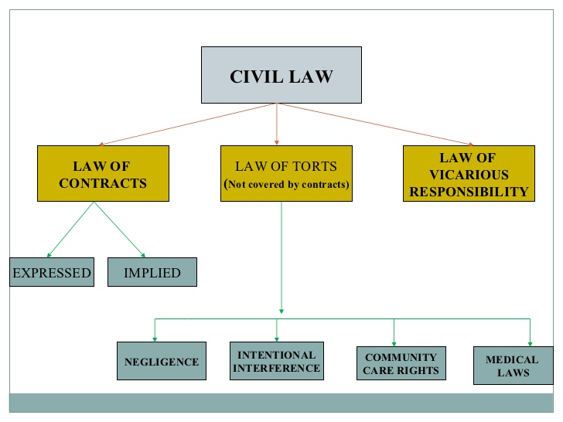

Slide 22
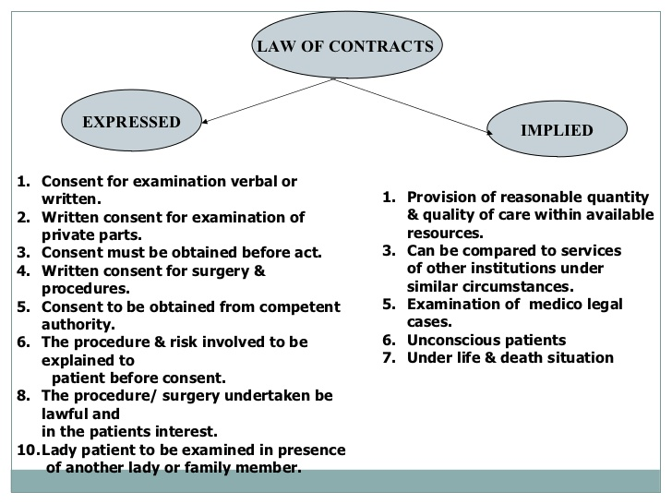

Slide 23
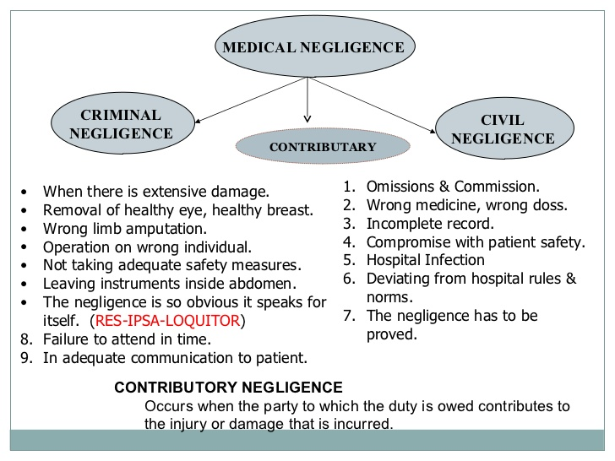

Slide 24
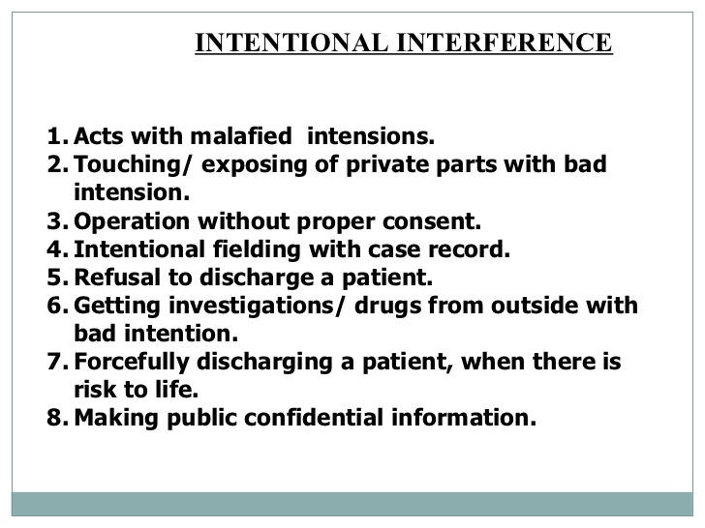

Slide 25
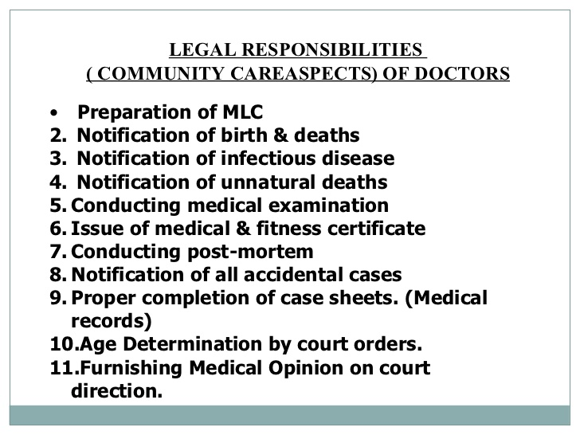

Slide 26
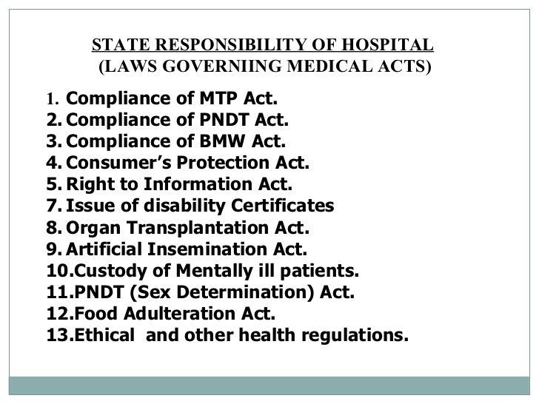

Slide 27
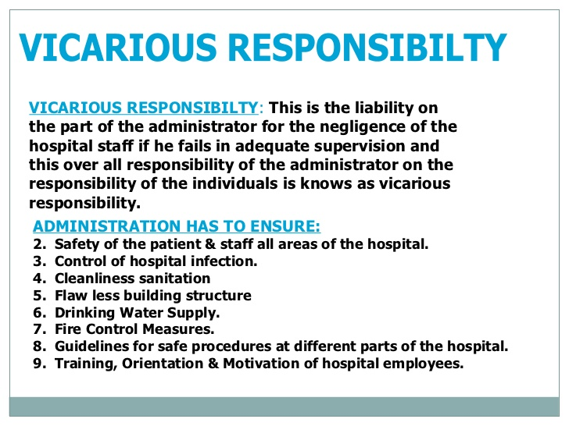

Slide 28
